Slide 1


Version Control System Git and Github
Lecture # 01
HITEC University, Taxila
Mr. Mubashir Iqbal
Fall-2025

Slide 2


What is Git?
Git is a tool that helps programmers keep track of their code. Think of it like a time machine for your projects—you can go back to any point in time and see what your code looked like.
Git was made by Linus Torvalds (the same person who created Linux) in 2005.
It is now used by developers all over the world to work together on the same project without overwriting each other’s work.

Slide 3
Why do we use Git?
To track changes in code
To know who made the changes
To collaborate with others easily
To revert (go back) if something breaks
More than 70% of developers use Git today!

Slide 4
Key Git Concepts
Repository (Repo): A special folder where Git stores your project and remembers its history. (Example: A folder of your Python AI project on your laptop.)
Clone: Make a copy of a project from the internet (GitHub) to your computer.
Stage: Tell Git which files you want to save. (Think: putting items in a basket before checkout.)
Commit: Save the staged files permanently in Git’s history. (Think: taking a snapshot or saving a version of your project.)

Slide 5
Key Git Concepts
Branch: Work on a new idea without disturbing the main project. (Like having two versions of the same game—one stable, one experimental.)
Merge: Combine changes from one branch into another.
Pull: Get the latest changes from GitHub onto your computer.
Push: Send your changes from your computer to GitHub.

Slide 6
How Git Works (Step by Step)
You initialize Git in a folder → it becomes a Git repository.
Git secretly creates a hidden folder (.git) to track everything.
When you change a file → Git marks it as modified.
You stage the file → tell Git “I want to save this.”
You commit → Git takes a snapshot of your files.
Git keeps a full history of commits so you can:
See who changed what
Roll back to an older version if needed
Work together without losing code
Note: Git is very smart—it doesn’t store copies of entire files each time. It only remembers the changes you made

Slide 7
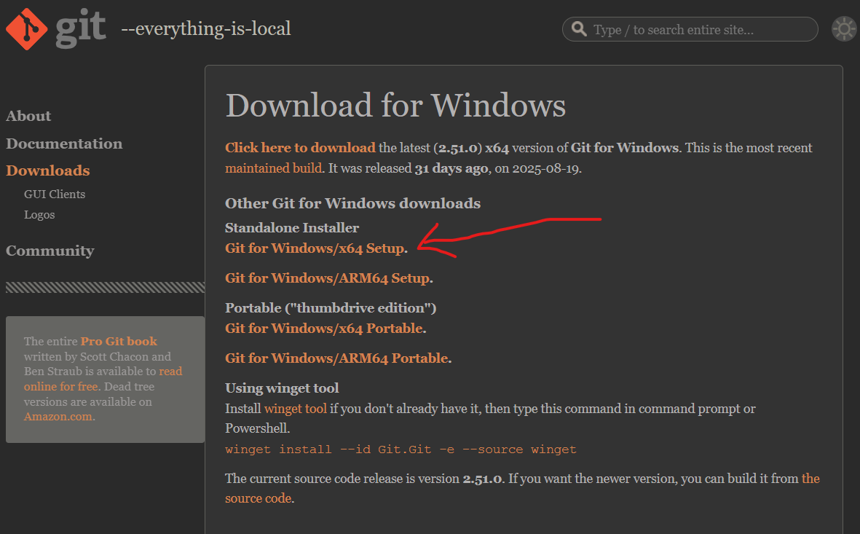
Download & Install
You can download Git for free from git-scm.com.
Windows: Download and run the installer. Click “Next” to accept the recommended settings. This will install Git and Git Bash.
After installation, you will be able to use Git from your terminal or command prompt.

Slide 8
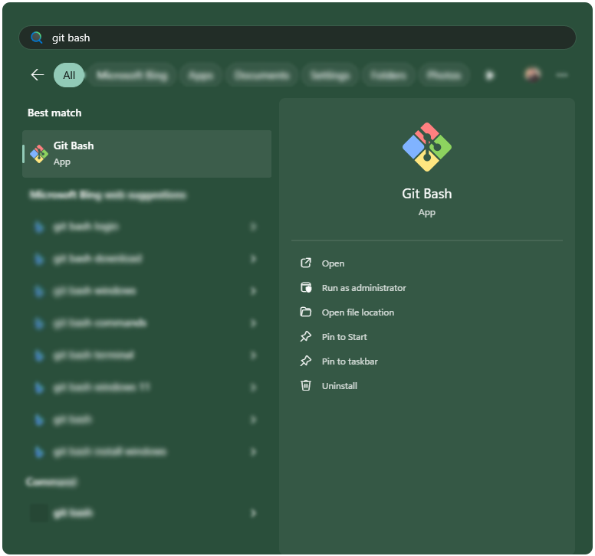
Accessing and Configuration
Git Bash is a terminal for Windows that lets you use Git commands.
Look at our Bash Tutorial to learn more about Bash.
After installing Git, you can find Git Bash in your Start menu.
You can use Git Bash just like the Command Prompt, but with extra Unix commands (like ls and pwd).

Slide 9
Git Config
This is important for version control systems, as each Git commit uses this information:
User Name
Your name will be attached to your commits. Set it with:
git config --global user.name "Your Name"
Email Address
Your email is also attached to your commits. Set it with:
git config --global user.email "you@example.com"
Note:
Use --global to set the value for every repository on your computer.
Use --local (the default) to set it only for the current repository.

Slide 10
Why Configure Git?
Git uses your name and email to label your commits.
If you do not set these, Git will prompt you the first time you try to commit.
Now you have added the minimum of configuration needed to start using Git.
More Commands
You can see all your Git settings with: git config --list
Set Default Branch Name: git config --global init.defaultBranch main

Slide 11
How it works
1. Project Folder
Make a project folder, that contain all your necessary files related to project
mkdir myproject
cd myproject
mkdir creates a new directory.
cd changes our working directory.
Now we are in the correct directory and can initialize Git!

Slide 12
How it works
2. Initialize Git
Now that we are in the correct folder, we can initialize Git on that folder:
git init
# Initialized empty Git repository in /Users/user/myproject/.git/
You just created your first Git Repository!
What is a Repository?
A Git repository is a folder that Git tracks for changes.
The repository stores all your project’s history and versions.

Slide 13
How it works
3. Git New Files
What is a New File?
A new file is a file that you have created or copied into your project folder, but haven’t told Git to watch.
Here are the key things to know:
Create a new file (with a text editor)
ls - List files in the folder.
git status - Check which files are tracked.
Understand untracked and tracked files.

Slide 14
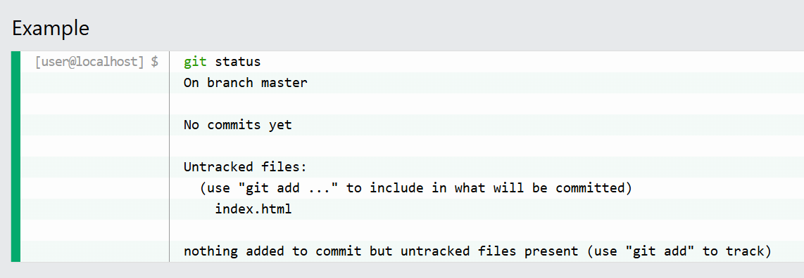
How it works
3. Check File Status with git status
Now check if Git is tracking your new file:

Slide 15
How it works
3. Git New Files
What is an Untracked File?
An untracked file is any file in your project folder that Git is not yet tracking.
These are files you’ve created or copied into the folder, but haven’t told Git to watch.
What is a Tracked File?
A tracked file is a file that Git is watching for changes.
To make a file tracked, you need to add it to the staging area (covered in the next chapter).
Troubleshooting
File not showing up with ls: Make sure you saved it in the correct folder. Use pwd to check your current directory.
File not listed in git status: Make sure you are in the correct folder and that you saved the file.

Slide 16
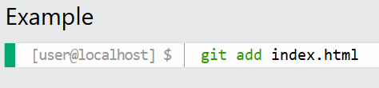
How it works
4. Git Staging Environment
The staging environment (or staging area) is like a waiting room for your changes. You use it to tell Git exactly which files you want to include in your next commit. This gives you control over what goes into your project history.
Here are some key commands for staging:
git add <file> - Stage a file
git add --all or git add -A - Stage all changes
git status - See what is staged
git restore --staged <file> - Unstage a file
You can check what is staged with git status.

Slide 17
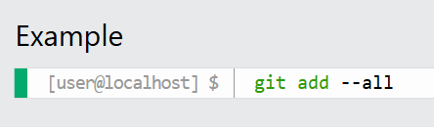
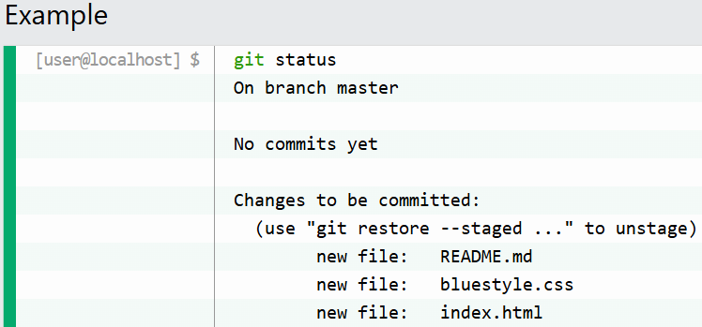
How it works
4. Stage Multiple Files (git add --all, git add -A)
You can stage all changes (new, modified, and deleted files) at once:
Check Staged Files with git status

Slide 18
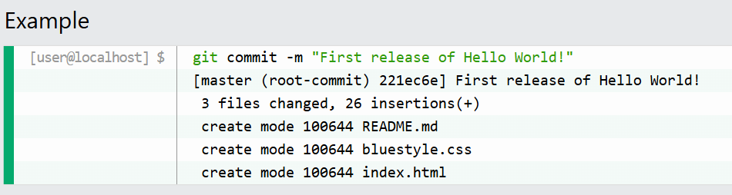
How it works
5. Git Commit
A commit is like a save point in your project. It records a snapshot of your files at a certain time, with a message describing what changed. You can always go back to a previous commit if you need to.
Here are some key commands for commits:
git commit -m "message" - Commit staged changes with a message
git commit -a -m "message" - Commit all tracked changes (skip staging)
git log - See commit history

Slide 19
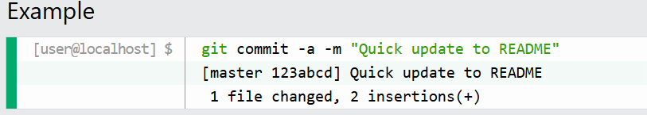
How it works
5. Commit All Changes Without Staging (-a)
You can skip the staging step for already tracked files with git commit -a -m "message".
This commits all modified and deleted files, but not new/untracked files.

Slide 20
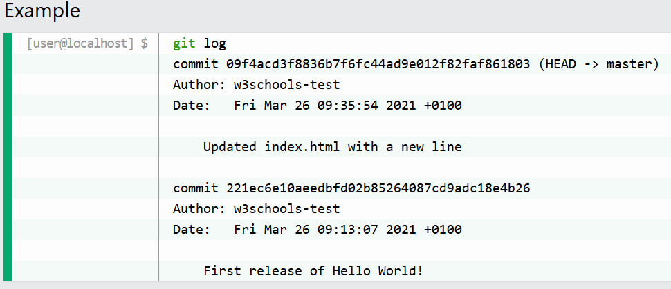
How it works
6. View Commit History (git log)
To view the history of commits for a repository, you can use the git log command:

Slide 22
Congratulations
You just completed your first lecture on Git

Slide 23


